Slide 1


Hybrid Cloud Storage for Virtualised Environments
Connect to any Virtual Private Cloud on AWS,
at other clouds, and on your premises.

Slide 2

Today’s Speaker
Steve Costigan
Senior Director International Solutions Architects
Zadara

Slide 3

Agenda
Enterprise Data Management for Hybrid IT
Enhancing VMware Use Cases
Why Partner with Zadara
Q&A

Slide 4
Control of the enterprise.
Agility of the cloud.
Why Zadara?

Slide 5
Enterprise DATA MANAGEMENT WITH Cloud ECONOMICS
Multi-Tier
Multi-Location
Multi-Tenant
Cloud Scalability
Cloud Economics
Scale Up
Scale Down
Change Technology
On-Demand

Slide 6

Any Protocol
Any Data Type
FC, iSCSI, iSER
NFS, CIFS
S3, Swift
Block
File
Object
Any Location
On Premises
Public or Private Cloud
Hybrid
A Complete Data Storage Service, Any Protocol, Any Data Type, Any Location

Slide 7











Agile, secure data management for hybrid it
On Premises
Service Provider Cloud
Hyperscale Public Cloud
Enterprise Data Cloud
Integrated Data Services & Apps
Antivirus
Backup
DR
VMware
Containers
FS&S
HA
Archive
DFS
MSFT
ROBO
More…
Zadara Private Storage Cloud
Virtual Private Storage Array
Object Store
Big Data/Analytics
Dev Ops
Field Sales
IT Operations
Production
Remote Offices

Slide 8
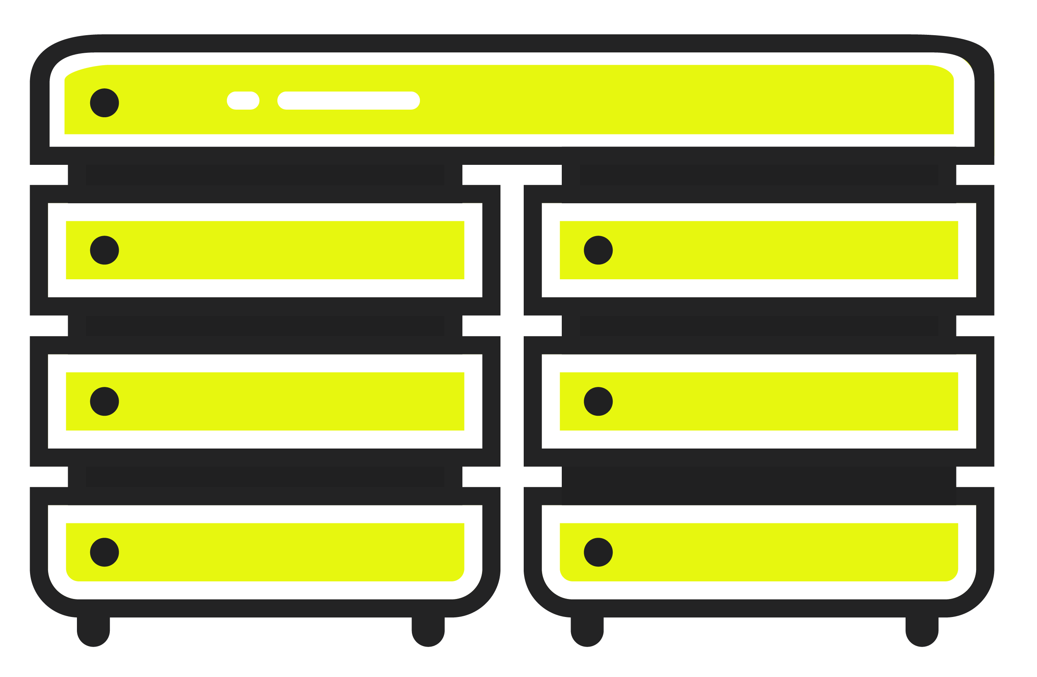
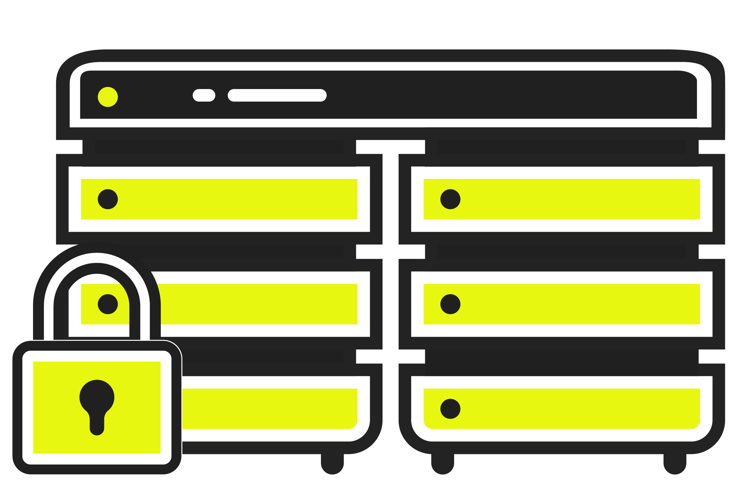
VPSA Storage Array
NFS, CIFS, BLOCK
ZCS (Docker)
10-100GbE, Fibre Channel
VPSA Object Storage
S3 / Swift / 2-way / 3-way / EC
Multiple Accounts/Tenants
Auto scale out – Just add drives
Zadara Storage Cloud
Multi-tenant
Software Defined Storage
Software Defined Networking
Deploy Anywhere
24x7 As-a-Service Management
OpEx
VPSA All Flash Array
VPSA + All Flash Storage
NVMe Cache
Dedupe & Compression
VPSA Connectivity
HA Private/Public Networking
1, 10, 40 and 100 GbE
Fibre Channel
Zadara Enterprise Data Storage Cloud Platform

Slide 9

Multi-tenant efficiency – single tenant experience
Active Flash Optimized Controller Core
Standby Flash Optimized Controller Core
Active VPSA Array Controller Core
Standby VPSA Array Controller Core
Active Object Storage Controller Core
Unallocated and Available Cores
Each Customer Has
Software Defined Networking:
  Private VLAN
  Layer 2/3
  SR-IOV
Software Defined Storage:
  Physical Drives, SATA+SSD
  vCPUs
Scale Up, Down and Scale Out
  Pay as you Go, OpEx
Allocated SSD
Allocated HDD
Available Disks

Slide 10








Powerful capabilities, capably managed
Block, file and
object storage
All-Flash + dedupe;
SSD cache options
Thin provisioned volumes
Large volume sizes
NFS, CIFS (AD),
FC, iSCSI, iSER
Multi-zone
high-availability
Kubernetes
Support
Remote
mirroring
Cluster
support
At-rest, in-flight
data encryption

Slide 11

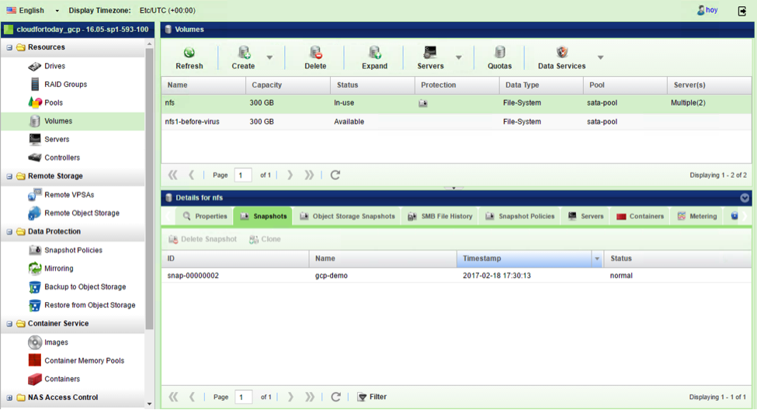
Visibility, knowledge and control
Zadara gives you total control over your entire enterprise storage system,
through a convenient web-based management interface.
Software-defined storage
Analytics, performance metrics
Elastic provisioning
Chargeback actual usage
Add or reduce storage capacity

Slide 12
Use Cases
Exemplary use cases for Hybrid Cloud Storage for
Virtualised Environments

Slide 13

FC Block, Ethernet block, NAS and object services
HOST SERVERS
Software Defined Storage for Specific Workloads
Choice of SSD and NL-SAS with Hybrid Caching Layer
Block – iSCSI, iSER, FCP-SCSI
File - SMB/CIFS AD, NFS
Object – S3 and Swift compatible
Local Snapshots
Remote Snapshots for Disaster Recovery
Backup to Object Storage for Archive
Anti-Virus
Scale Up or Down as Needed
VLAN 20
(Development)
Fibre Channel SAN
VLAN 10
(Production)
VPSA 3
SSD
NFS Shares
Backup
VPSA 1
All Flash Array
NVMe Cache
Dedupe
Compression
Block
DR
VPSA 2
NL-SAS
SSD Cache
User Shares
Backup
Anti-Virus
VPSA Object
S3 /Swift
Archive
Backup Tier

Slide 14

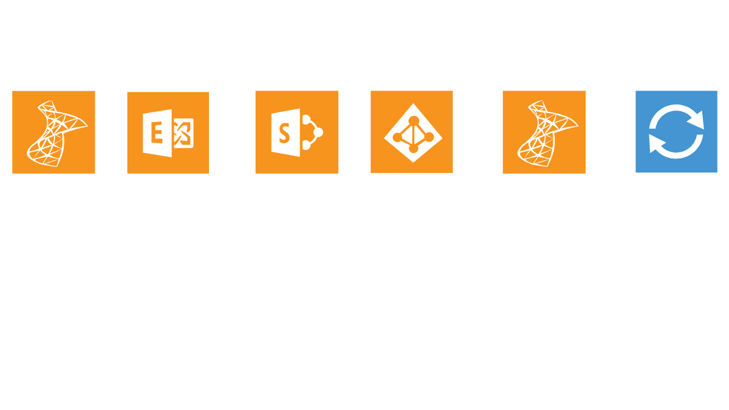

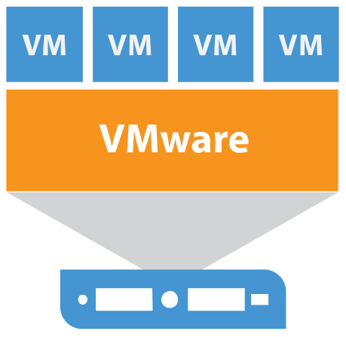
Adding Zadara to VMware Cloud on AWS
Learn more:
https://www.zadara.com/sol_vmware_cloud.php
VPC
VMware Cloud on AWS
File
Block
Zadara VPSA Block, File and Object
  Data replication flexibility
    Snapshots, Clones, Remote mirroring
Storage medium flexibility
  All-flash, all-HDD, hybrid flash plus HDD
Storage type flexibility
  File, block, and object (S3, Swift)
  File: NFS 3 & 4, CIFS
  Block: iSCSI, Fibre Channel
  Location flexibility
    Zadara-hosted, on-premises
    Private clouds, public clouds, multi-cloud
  Microsoft enterprise application support
    Volume Snapshot Service (VSS)
    Windows Server Failover Clustering (WSFC)
    Active Directory (AD)

Slide 15
Data Center Extension
VPC
VMware Cloud on AWS
File
Zadara VPSA
Block
VPC
  No migration required
    Initial migration
    Subsequent bi-directional workload migrations
    Same copies of data can be shared between on-premises and AWS-based VMware Clouds
  Use cases
    Analytics & machine learning
    Application-consistent backups
    Test & dev
VMware SDDC in Co-lo

Slide 16
Business Continuity
VPC
VMware Cloud on AWS
File
Zadara VPSA
Block
VPC
Remote
Mirroring
VMware SDDC on Premises/MSP
File
Zadara VPSA
Block

Slide 17
Run WSFC Using SQL Standard
VPC
Windows Server Failover Cluster
File
Zadara VPSA
Block
  IF
    You run Windows Server Failover Clustering
    You have multiple SQL Server databases
    You have Microsoft Software Assurance
  AND
    You need clustered SQL Server for availability
  BUT
    Required performance for each database can be delivered by single SQL Server instances
  THEN
    You may be able to leverage WSFC with SQL active/passive failover
  TO
    Use Standard SQL Server instead of Enterprise Licenses
Learn more:
https://www.zadara.com/solutions/use-case/sql_server_aws.php

Slide 18

Cloned Production Volumes
VPC
VMware Cloud on AWS
File
Zadara VPSA
Block
VPC
  Use cloned production volumes to:
    Populate analytics data sets
    Test new versions and patches
    Anonymize data (GDPR)
    All of the above – make as many clones as you want
VMwareSDDC On-Premises/MSP
Clone
Zadara VPSA

Slide 19




Veeam zip code backup with zadara -3-2-1-1-0
Veeam’s ‘3-2-1-1-0’ data protection best practice ensures data is completely protected from threats of all types — even ransomware
3
2
1
1
3
2
1
1
0
different copies
of data
different media
of which is offsite
of which is immutable or offline
errors after backup recoverability verification

Slide 20
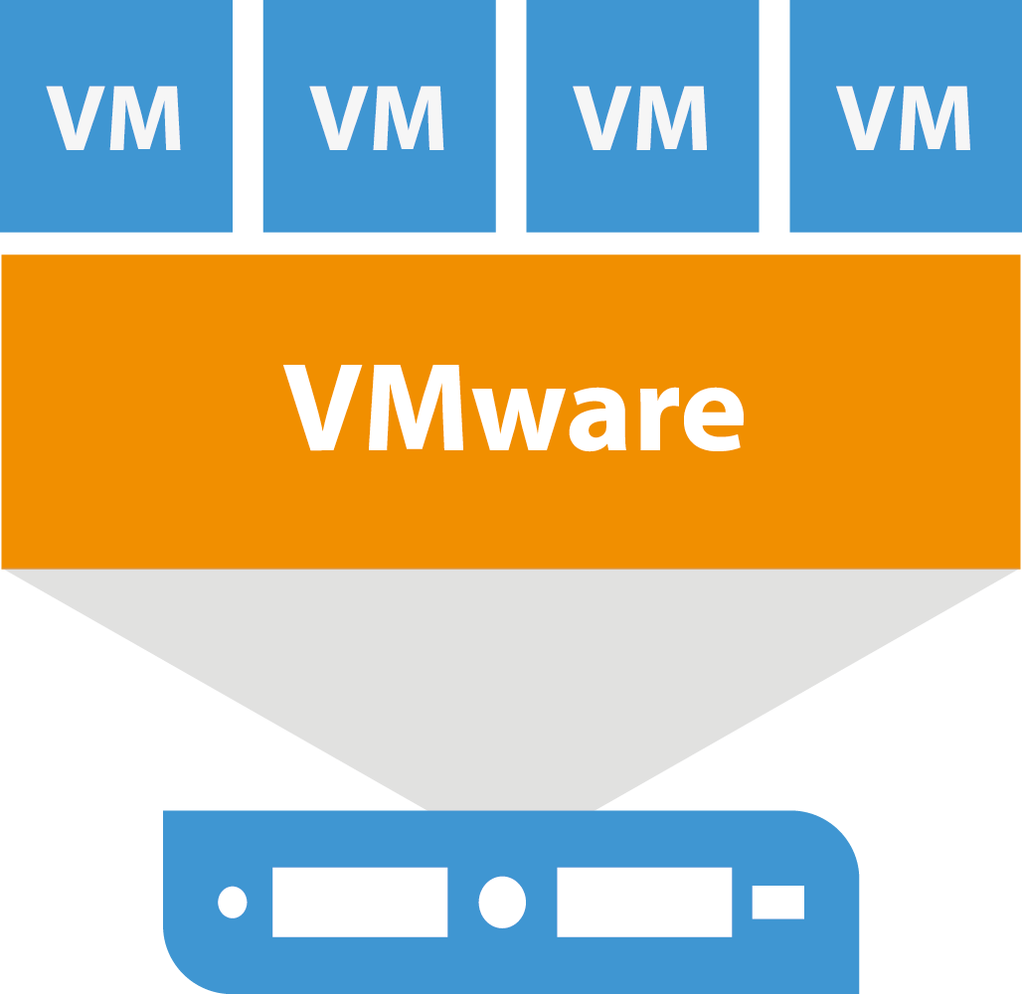



Complete end to end backup solution
VPSA Object Storage
On-premises SOBR Cloud Tier for long-term retention
Backup copy
VPSA Storage Array
On-premises Secondary backup storage
Backup
Cloud Connect
VCSP/MSP
Production storage
VPSA Object Storage
Offsite SOBR Cloud Tier for long-term retention
Long-Term Copy
VPSA Storage Array
Secondary backup storage (offsite)
VPSA Storage Array
Primary backup storage

Slide 21
Zadara and Veeam for Service Providers
Multiple Cloud Connect Customers
VCSP/MSP
Cloud Connect
Shared
Tenants
Dedicated Tenant A
Dedicated Tenant B
Multi-Tenant Object Storage
Multi-Tenant Block Storage
Complete Isolation between Tenants
VPSA Block and Object Offsite SOBR Cloud Tier for long-term retention

Slide 22
Why Partner with Zadara ?
We built this with you in mind

Slide 23

Secure encryption –you own the keys
Zadara is built with security in mind. Your data is stored on dedicated hardware, and protected with in-flight and at-rest encryption. Also, because you manage your keys, only you control access to your data.

Slide 24

24/7 Management.
100% Guaranteed.
Live, proactive management 24/7/365
100%-uptime guarantee
Notifications, alerts based on operating thresholds
Periodic, non-disruptive hardware and software upgrades at No Cost
Expert DevOps team builds solutions to complex storage challenges

Slide 25
Worldwide datacentre coverage
Thousands of storage arrays in hundreds of data centres across five continents

Slide 26
Control Your Data. Control Your Costs.
Simplify your storage. Increase productivity. Decrease costs.
Avoid large investments in storage infrastructure
Convert CapEx storage to OpEx
Reduce storage administration costs; redeploy people to higher-value tasks
Scale up or down as needed;
never pay for unused capacity
Series of Events:
Y1: Initial Need + Growth
Y2: Shrink (Lost Customer)
Y3: New Customer
Y4: Tech Refresh (e.g. dedupe)
Legacy Storage
(over-provisioning)
Wasted
Spend
Actual Usage
Zadara
100%-OpEx
Year 1
Year 2
Year 3
Year 4
Year 5
Source: The Evaluator Group 2016

Slide 27
Upgrade Your Technology. Lower Your Costs.
Upgrade to the latest components on your schedule, not ours. Rest easy with non-disruptive, zero-cost refreshes. Save money by transitioning to newer, more cost-effective storage.
$0.030
$0.028
$0.026
$0.024
$0.022
$0.020
$0.200
$0.170
$0.140
$0.110
$0.080
$0.050
2013
2014
2015
2016
2017
2018
2019
HDD
SSD (NVMe introduced August 2019)

Slide 28



Your Enterprise Storage Service Partner
Zadara delivers enterprise-grade data storage services in an agile cloud model,
with 24/7 expert management — leaving you free to focus on your customers.
Enterprise-Grade Performance and Security
Agile, Infinite Storage.
Pay Only for Usage.
Expert Management
24/7/365
Dedicated SSDs and HDDs,
in-flight and at-rest encryption, snapshots, mirroring, HA, more
On premises and in the cloud, scale up or down, pay as you go, hardware upgrades included
24/7/365 proactive support,
seamless migrations, upgrades, from senior technical resources
Fully Featured
Fully Elastic
Fully Managed

Slide 29
Why our Partners choose Zadara ?
Because we built this with them in mind

Slide 30












Trusted by Leading Companies Worldwide

Slide 31



K3 Business Technologies
MANAGED SERVICES
Challenge:
Replace their older EMC and NetApp arrays
Required HA/DR solution
Leverage an OpEx as-a-service model
Results:
Deployed an enterprise-class high-availability disaster recovery architecture
Improved VMware performance by 33% using iSER instead of iSCSI
Deployed an ‘On-Premises as-a-Service’ solution to keep physical storage within their data centers
“We saw significant savings moving to Zadara’s consumption approach that complements our business model.”
Steve Donoghue
Director of Hosting Services
K3 Business Technologies

Slide 32



Softcat
MANAGED SERVICES
Challenge:
Deliver unified, multi-tenant storage that scales up and down, and is 100% OpEx
Results:
Dedicated resources deliver consistent performance, superior to previous solution
Burst capacity allows Softcat to respond quickly to customer demand, avoid migration
Chargebacks simplify billing
Redirected staff to proactive, revenue-generating projects
“Not only do Zadara have an agile financial model, they also have a fantastically agile operations team that supports our business 24/7.”
Paul Hyde
Softcat

Slide 33


On-Premises and Cloud Free Trial
zadara.com/freetrial
Go to zadara.com/freetrial
(No credit card required.)
Configure your Virtual Private Storage Array: drives, capacity, containers, more
Contact sales@zadara.com for more information on on-premises installation
Free training and support throughout your trial. Reach out to us anytime at: support.zadara.com

Slide 34

Enterprise control. Cloud agility.
www.zadara.com/

